Slide 1
Human Milk: “A Source of More Life Than We Imagine”
Terry S. Johnson, APN, NNP-BC, ASPPS, MS
Director, Education and Professional Development
Prolacta Bioscience

Slide 2
Disclosures
Director of Education and Professional Development
Prolacta Bioscience
I personally prepared this slide deck; it is without commercial bias or influence
I have received financial reimbursement for non-marketed, non-branded, non- promotional educational presentations through the Abbott Nutrition Health Institute (ANHI)
Terry S. Johnson
APN, NNP-BC, ASPPS

Slide 3
Objectives
Describe the role of inflammation in the development of “dysbiosis”
Identify the role of the Gut-Breast Axis in reducing inflammation-driven comorbidities
Define the term “dose response” in relationship to a human milk diet
Discuss the significance of human milk as a “biologic” substance
Identify neonatal comorbidities that are reduced with an exclusive human milk diet
List three factors in human milk that are reduced through retort pasteurization

Slide 4
Human Milk: A Source of More Life Than We Can Imagine
Human Milk
Neonatal Microbiome
Human Milk
“A Source of more life than we imagined.”
“The sum of all microbial life living in or on the human body.”
Jeurink PV, et al., Human milk: a source of more life than we imagine. Beneficial Microbes. 2013; 4(1); 17-30. doi. 10.3920/BM2012.0040
Gritz EC & Bhandari V. The human gut microbiome: a brief review. Frontiers in Pediatrics. 2015; 3(17); doi:10.3389/fped.2015.00017

Slide 5
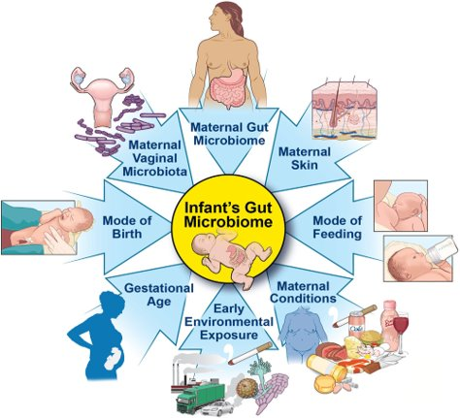
Human Milk: A Source of More Life Than We Can Imagine
Functions of the Microbiome
Assists with essential nutrient synthesis absorption
Influences the infant’s growth
Maintains intestinal mucosal barrier
Generates SCFA – energy source
Prevents pathogenic bacteria/endotoxin translocation
Provides anti-inflammatory signals to the host
Stimulates immune system maturation
Kapourchali FR, Cresci GAM. Early-life gut microbiome—the importance of maternal and infant factors in its establishment. Nutr Clin Pract. 2020;35(3):386-405. doi:10.1002/ncp.10490

Slide 6
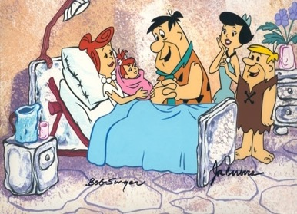
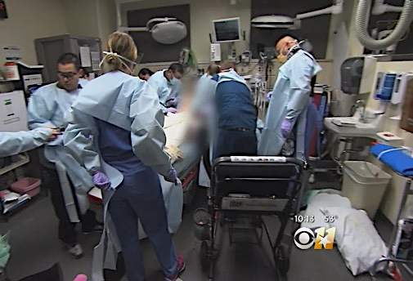
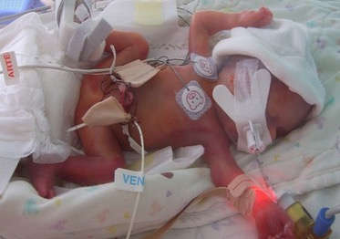
Human Milk: A Source of More Life Than We Can Imagine
“Evolutionary Biology”
“Evolutionary Biology Disrupted”
For millennia women have labored and delivered and breastfed babies …
For 60+ years women have had more complex pregnancies and deliveries …
For 60+ years babies have been born smaller and younger and survived …

Slide 7
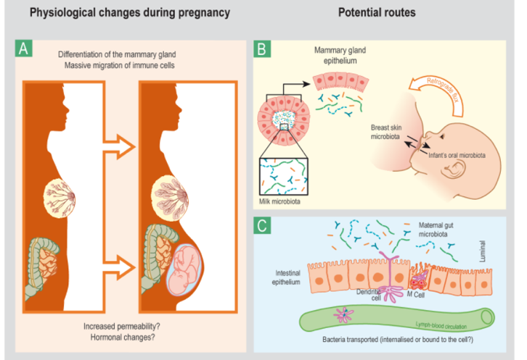
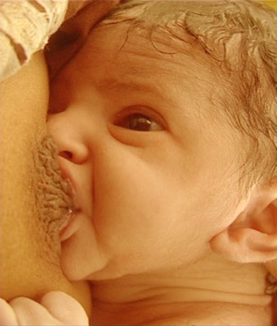
Human Milk: A Source of More Life Than We Can Imagine
“Bacterial Imprinting”
Maternal Microbiome Maternal Antibodies
Korpela K, Helve O, Kolho KL, et al. Maternal fecal microbiota transplantation in cesarean-born infants rapidly restores normal gut microbial development: a proof-of-concept study. Cell. 2020;183(2):324-334.e5. doi:10.1016/j.cell.2020.08.047

Slide 8
Preterm Birth, the Microbiome, and Origin of Dysbiosis
Innate Immunity
Provides immediate protection
Functions at a local/cellular level
Acts with non-specific responses
“PRO-INFLAMMATORY” mechanisms
Vasodilatation
Cellular activation
Microvascular permeability
Coagulation
More diffuse response Secondary/collateral damage
Adaptive Immunity
Later developed immune response
Requires exposure to antigens
Amplifies with repeated exposure
“LESS-INLAMMATORY” mechanisms
Relies on T & B cells and “memory”
Elaborate cascade of responses
Highly specific response
More modulated response
More localized
Less secondary/collateral damage
Cacho NT, Lawrence RM. Innate immunity and breast milk. Front Immunol. 2017;8:584. doi:10.3389/fimmu.2017.00584 Jakaitis BM, Denning PW. Human breast milk and the gastrointestinal innate immune system. Clin Perinatol. 2014;41(2):423-435. doi:10.1016/j.clp.2014.02.011

Slide 9
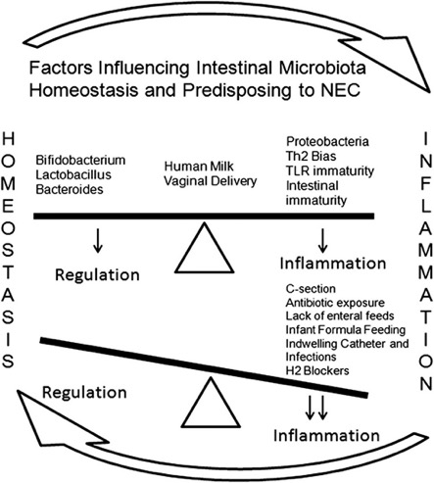
Human Milk: A Source of More Life Than We Can Imagine
?
Preterm/Sick
Term/Well
DYSBIOSIS
Inflammation
Dysregulation
Altered Microbiota
Dysbiosis
Torrazza RM, Neu J. The altered gut microbiome and necrotizing enterolcolitis. Clin Perinatol. 2013;40(1)93-108. doi:10.1016/j.clp.2012.12.009 Underwood MA, Umberger E, Patel R. Safety and efficacy of probiotic administration to preterm infants: ten common questions. Pediatr Res. 2020;88(Suppl 1):48-55. doi:10.1038/s41390-020-1080-6

Slide 10
Human Milk: A Source of More Life Than We Can Imagine
?
Preterm/Sick
Term/Well
DYSBIOSIS
Necrotizing
Enterocolitis
Retinopathy of
Prematurity
Bronchopulmonary
Dysplasia
Late-Onset
Sepsis
Torrazza RM, Neu J. The altered gut microbiome and necrotizing enterolcolitis. Clin Perinatol. 2013;40(1)93-108. doi:10.1016/j.clp.2012.12.009 Underwood MA, Umberger E, Patel R. Safety and efficacy of probiotic administration to preterm infants: ten common questions. Pediatr Res. 2020;88(Suppl 1):48-55. doi:10.1038/s41390-020-1080-6

Slide 11
Human Milk: A Source of More Life Than We Can Imagine
What is “Prehab”?
A preventive mechanism to decrease the risk of injury and/or to optimize your functional ability and quality of life
Described as “prehabilitation” or “preventive rehab” with the goal of reducing the risk for injury
Focuses on efforts to decrease the burden on individuals and the healthcare system
This Photo by Unknown Author is licensed under CC BY-NC-ND

Slide 12
Human Milk: A Source of More Life Than We Can Imagine
AAP Policy: 2017
“Human Milk is a Biological Product”
What is a biologic product?
Biological products, or biologics, are medical products
Many biologics are made from a variety of natural sources (human cells, tissue, animal, microorganism)
Like drugs, some biologics are intended to treat diseases
22 reviews of 14 different disease states ↓ risk
Biologics are used to prevent or diagnose diseases
U.S. Food and Drug Administration. FDA Basics; What is a biological product? U.S. Department of Health and Human Services .http://www.fda.gov/AboutFDA/Transparency/Basics/ucm194516.htm Page Last Updated: 05/31/2016

Slide 13
Human Milk – Contains Over 100,000 Components
Human Milk: A Source of More Life Than We Can Imagine
Anti-Microbial Factors
Secretory IgA, IgM, IgG
Lactoferrin
Lysozyme
Complement C3
Bifidus factor
Antiviral mucins, GAGs
Oligosaccharides
Cytokines & Anti-Inflammatory
Tumor necrosis factor
Interleukins
Interferon
Prostaglandins
Platelet-activating factor
A-1 anti-trypsin
A-1 anti-chymotrypsin
Transporters
Lactoferrin
Folate binder
Cobalamin binder
IgF binder
Tryoxine binder
Corticosteroid binder
Hormones
Insulin
Prolactin
Thyroid hormones
Corticosteroids
Oxytocin
Calcitonin
Parathyroid hormone
Erythropoietin
Digestive Enzymes
Amylase
Bile acid-stimulating
Bile acid-stimulating lipase
Lipoprotein lipase
Ribonuclease
Growth Factors
Epidermal (EGF)
Nerve (NGF)
Insulin-like (IGF)
Transforming (TGF)
Polyamines
Others
Lycopene
Leptin
Lutein
DNA & RNA
Casomorphins
Sleep peptides
Stem cells

Slide 14
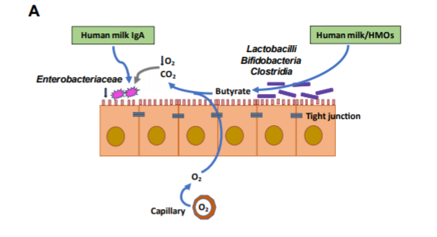
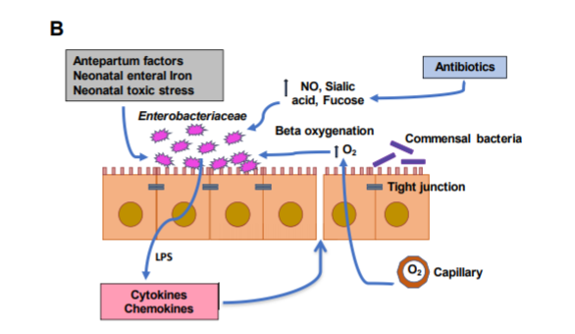
Human Milk: A Source of More Life Than We Can Imagine
Non-inflamed neonatal bowel
Inflamed neonatal bowel
Protective Role of Human Milk
Dysbiosis Related Inflammation
Groer MW, Miller EM, D’Agata A, et al. Contributors to dysbiosis in very-low-birth-weight infants. J Obstet Gynecol Neonatal Nurs. 2020;49(3):232-242. doi:10.1016/j.jogn.2020.02.003

Slide 15
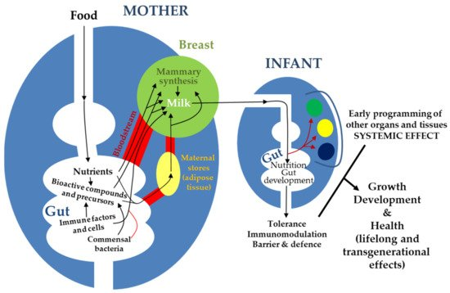
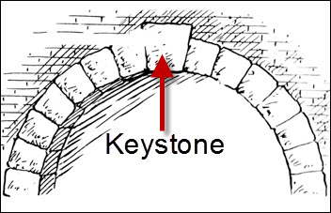
Human Milk: A Source of More Life Than We Can Imagine
Gut-Breast Axis
Role in Evolutionary Biology – Immunity
Complex neuroendocrine system
Maintains
Vast/complex network of nervous, metabolic, endocrine signals
Enteric neurotransmitters that operate in our brain
Constant exchange of information the with brain/other organs
“Keystone” of the Immune System
Monitors/samples enteric environment
Responds to antigens
Controls/eliminates pathogens
“Central stone at the summit of an arch, locking the whole together”
Rodríguez, J.M.; Fernández, L.; Verhasselt, V. The Gut-Breast Axis: Programming Health for Life. Nutrients 2021, 13, 606. https://doi. org/10.3390/nu13020606
Notes:
KEYSTONE -

Slide 16
Human Milk: A Source of More Life Than We Can Imagine
↑Axes/Functional Connections
Gut-brain axis
Gut-liver axis
Gut-kidney axis
Gut-skin axis
Gut-joint axis
Gut-bone axis
Gut-heart axis
Gut-spleen axis
Gut-pancreas axis
Gut-eye axis
Gut-Breast Axis
Gut Mucosal Tissue
Seen primarily as the “conduit” for nutrition
Potential for both PRO/ANTI inflammatory activity
Emerging microbiome
Largest interface with “other”
“Global Immunologic Organ”
Rodríguez, J.M.; Fernández, L.; Verhasselt, V. The Gut-Breast Axis: Programming Health for Life. Nutrients 2021, 13, 606. https://doi. org/10.3390/nu13020606

Slide 17
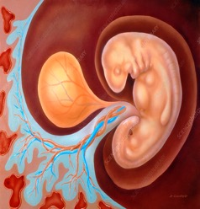
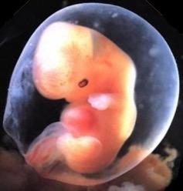
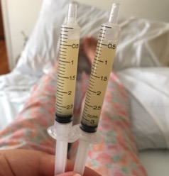
Human Milk: A Source of More Life Than We Can Imagine
The Four “Biologics” or “Immunizations” or “Benefits” or “Continuums” of Human Milk
Womb Milk
Amniotic Fluid
Colostrum
Breastmilk
Other

Slide 18
Human Milk: A Source of More Life Than We Can Imagine
BLOOD COMPONENTS
> 100,000 components
Red blood cells
Leukocytes
Platelets
Plasma
Hemoglobin
Albumin
Clotting Factors
Gamma Globulin
HM COMPONENTS
> 100,000 components
Antimicrobials
Cytokines
Enzymes
Hormones
Growth factors
Transporters
Binding Proteins
HMOs
HUMAN
MILK
BLOOD
“Human milk is a biologically active delivery system”

Slide 19
Human Milk: A Source of More Life Than We Can Imagine
“Dose Response” of an CMBD verses an EHMD
For every 10% increase in CMBD
a 12% INCREASE in NEC
For every 10% increase in CMBD
a 21% INCREASE in SURGICAL NEC
For every 10% increase in CMBD
17.9% INCREASE in SEPSIS
Abrams SA, Schanler RJ, Lee ML, Rechtman DJ. Greater mortality and morbidity in extremely preterm infants fed a diet containing cow milk protein products. Breastfeed Med. 2014;9(6):281-285. doi:10.1089/bfm.2014.0024

Slide 20
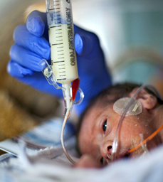
Human Milk: A Source of More Life Than We Can Imagine
“The Burdens of Prematurity”
EHMD
Mother’s own milk
Donor human milk
HM–based fortifiers
Reduction in NEC
Reduction in BPD
Reduction in ROP
Late-onset Sepsis
Sullivan¹ et al (2010)
Abrams² et al (2014)
Hair AB³ et al (2016)
Assad M⁴ et al (2016)
9.0% less BPD¹
16.5% less BPD²
8.6% less BPD³
15.0% less BPD⁴
13.5% less ROP³
8.6% less ROP⁴
3.8% less ROP⁵
Up to 26% less ROP⁶
For every 10% ↑ CMBD 17.9% ↑ late-onset sepsis¹
11.3% reduction in LOS²
10.5% reduction in LOS³
12.5% less LOS evaluations⁴
REFERNCES AVAILABLE UPON REQUEST

Slide 21
Human Milk – Contains Over 100,000 Components
Human Milk Research in the last 15+ Years has Grown and Evolved
2004: Immunobiology of HM (Hanson)
2007: First discovery of stem cells in HM
2009: 261 previously unidentified proteins were found in HM
2012: Identification/clinical role and abundance of HMOs
2015: 300 new microRNA molecules were characterized in HM
2020: HM as part of a “global immunologic organ”
2021: HM as a “biological system”
Human milk research, clinical trials, and are accelerating

Slide 22
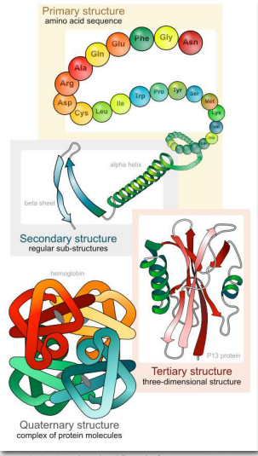
Human Milk: A Source of More Life Than We Can Imagine
Proteins are the Workhorses of the Cell
Cellular reactions
Mediates cell signaling
Provides structure
Gene expression
20 amino acids (AA) makes 20^{n} possible combinations
A peptide of 2 amino acids makes 20² = 400 combinations
10 amino acids makes 20¹⁰ = 10,240,000,000,000, combinations
Structure is the 3-D “conformation” or tri-folded protein
Conformation determines the function of the protein
The versatility of proteins arises because of their varied structures
Rajagopal KA, Indira &Tan T(2021, March 6 Structure and Function-Proteins1. Oregon State University.
https://bio.libretexts.org/@go/page/7810.
Notes:
“Life, as we know it, would not exist if there were no proteins”

Slide 23
Human Milk: A Source of More Life Than We Can Imagine
Protein Function Depends on Its Structure
Human milk proteins are complex and susceptible to processing methods
Processing temperature >72°C → fragmentation, reformation of aggregates
Results in permanent protein damage
Negatively impacts biological function
High temperature and pressure can change the shape of antibodies
Removes ability to recognize and bind to antigens
Affects protective feature antibodies typically provide
Notes:
Because physiochemical properties of individual proteins differ, processing affects the proteins differently.

Slide 24
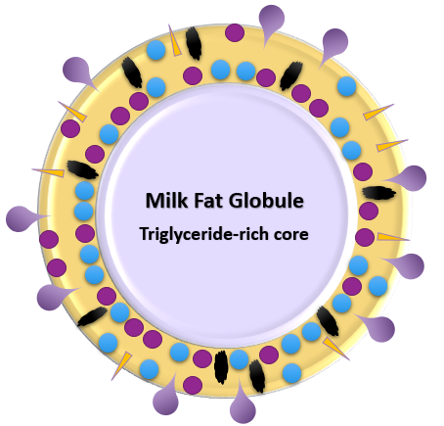
Human Milk: A Source of More Life Than We Can Imagine
Human MFGs (Milk Fat Globule) and MFGMs (Milk Fat Globule Membrane)
Vary in size, composition, and role
Provide rapid availability of energy
Influence lipid metabolism and absorption rates
Beneficial impacts on cognitive development
Contains essential fatty acids, DHA, ARA
Prebiotic functions
Growth factors
Intestinal, neural, cardiac, ocular development
Antimicrobial, anti-inflammatory properties
Mitigates oxidative stress
Difficult to mimic due to highly complex structure/variable composition
Lee H, Padhi E, Hasegawa Y, et al. Compositional dynamics of the milk fat globule and its role in infant development. Front Pediatr. 2018;6:313. doi:10.3389/fped.2018.00313
| Weiser MJ, Butt CM, Mohajeri MH. Docosahexaenoic acid and cognition throughout the lifespan. Nutrients. 2016;8(2):99. doi:10.3390/nu8020099 | Bosco A, Toto M, Pintus R, Fanos V, Dessì A. Human milk sphingomyelins and metabolomics: an enigma to be discovered. J Matern Fetal Neonatal Med. 2021:1-13. doi:10.1080/14767058.2021.1958314
Notes:
hundreds of proteins with lower abundance exist in the milk fat globule membrane, including lactoferrin and lysozyme

Slide 25
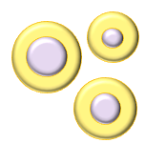
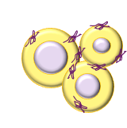
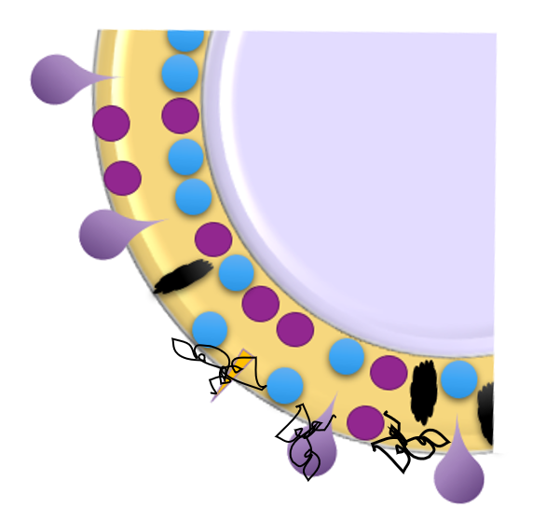
Human Milk: A Source of More Life Than We Can Imagine
Protein Function Depends on Its Structure
Effect of High Heat on the MFGM
Intact MFGM
Disrupted MFGM surface
Disrupted MFGM surface
Individual fat globules in native form or after low heat treatment
Aggregates of fat globules after high heat treatment
FUNCTION
Gassi JY, Famelart MH, Lopez C. Heat treatment of cream affects the physicochemical properties of sweet buttermilk. Dairy Sci. Technol. 2008;88.369-385. doi:10.1051/dst:2008006.

Slide 26
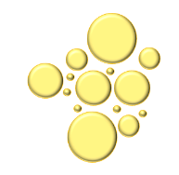
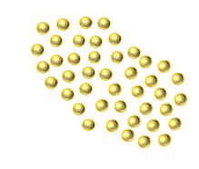
Human Milk: A Source of More Life Than We Can Imagine
Homogenization Process
Breaks down the milk fat globule into minuscule portions that are dispersed evenly throughout the milk
Achieved by pumping milk through small openings under very high pressure
? Effect of Human Milk Structures
The assembly of milk fat globules is evolutionary
Structural properties of milk regulate the digestion and absorption of each of the major macronutrients—carbohydrates, proteins, and fats
There is no evidence that the changed fat globule is functionally the same as the intact fat globule
Native milk fat globule
Milk fat globule after homogenization
Notes:
There are new products coming on the market that have been homogenized with the idea that less fat adheres to the feeding tubes, which seems like a great idea: more fat to the infant.
However, Milk and all of its components emerged through evolution under selective pressure to be nourishing. Like any other milk ingredient and structures, the assembly of milk fat globules evolved in order to promote the mammalian infants’ health. The structure of food influences how nutrient components are digested and absorbed
Structural properties of milk regulate the digestion and absorption of each of the major macronutrients—carbohydrates, proteins, and fat
There is no evidence that the changed fat globule is functionally the same as the intact fat globule

Slide 27
Human Milk: A Source of More Life Than We Can Imagine
Human Milk Fortification
Human milk-based fortifier associated with less alteration of milk fat globule size than cow milk-based fortifier
Comparison of CMBF vs HMBF added to DHM and its impact on milk fat globule (MFG)
At 24 and 48 hours after fortification, MFG size in the milk with CMBF was larger than that in the milk with HMBF
At 24 hours: 4.8 ± 0.5 vs 4.3 ± 0.3 μm, p<0.01
At 48 hours: 5.1 ± 0.7 vs 4.5 ± 0.4 μm, p=0.03
Structure Drives Function
Individual fat globules in native form
Milk fat globule aggregates
Notes:
This study was published just this month and compared the impact of human milk based and cow milk based fortifiers on human milk fat glolbules. They found greater alteration in MFG size with CMBF compared to HMBF
More efficient gastric digestion might be related to the structure and size of the MFG and may have an impact on feeding tolerance of very preterm infants

Slide 28
Human Milk: A Source of More Life Than We Can Imagine
Effect of Cow Milk-Based Products on Human Milk Proteins
Comparison of infants
Fed preterm HM only
Received both preterm HM and cow’s milk formula (50:50)
Some cow milk proteins form aggregates with breastmilk proteins
Function follows structure
Changes in protein structure likely limits their bioactivities in the gut
May explain why infants fed an exclusive HM–based diet have less feeding intolerance and lower rates of NEC?
Notes:
And just a word about combining cow milk-based products with human milk.
There have been a few studies done looking at the impact these products can have on the bioactive components of human milk. Adding cow milk-based products appears to promote formation of aggregates with breastmilk proteins and milk fat globules, which changes their shape and size. This could lead to changes in digestion and bioactivity, which may explain why infants fed an exclusive human milk diet have a lower incidence feeding intolerance and less NEC in preemies

Slide 29
Human Milk: A Source of More Life Than We Can Imagine
Pasteurization: Friend and Foe
Holder Pasteurization
Most common method in US
“Batch” milk from ~5 donors
Filled in individual bottles
Paced in hot water bath
~62.5°C for 30 minutes
Monitor “control” bottles
Potential for “fail points”
Vat Pasteurization
Used in the dairy industry
“Batch” from 100s of donors
Pooled/pasteurized in a vat
Entire “batch” monitored
Potential for less variability
Variability of protein levels
Non-secretor donors/HMOs
Retort Sterilization
Commonly used in food canning
Milk pooled ↑ number of donors
Heated to over 120°C
Effective in “sterilizing” milk of pathogens
Also destroys any remaining bioavailability

Slide 30
Preserving Bioactivity Naturally Found In Human Milk
Pasteurization: Friend and Foe
Decreased risk of infection/illness
Benefits infant growth, development, immunity, and long-term health
New pathogen inactivation methods are continually being developed/implemented
Current and new methods require stringent evaluation to understand their impact on the nutrition and bioactivity of DHM products
Pathogen Deactivation
Preserve Bioactivity
Notes:
Preserving Bioactivity Naturally Found In Human Milk Benefits Growth and Development, Immunity, and Long-term Health Of Preterm Infants

Slide 31
Human Milk: A Source of More Life Than We Can Imagine
Composition/Variation of Macronutrients, Immune Proteins, and HMOs In Human Milk From Nonprofit and Commercial Milk Banks
 | HM Reference | Vat Pasteurized | Retort Sterilized
IgA (g/L) | 0.32 | 0.38 | 0.19
Lysozyme (g/L) | 0.05 | 0.09 | 0.05
Lactoferrin (g/L) | 1.15 | 1.12 | 0.5
α-lactalbumin (g/L) | 3.9 | 3.7 | 0.95
HMOs (g/L) | 8.05 | 8.24 | 6.64

Slide 32
Human Milk: A Source of More Life Than We Can Imagine
Bacteria/Bioactivity In Holder Pasteurized and Shelf-Stable Human Milk Products
Method
Milk from 60 mothers was pooled.
12 were tested raw, 12 after pasteurization, and 12 after retort sterilization.
Results
sIgA activity retained:
Pasteurized 87%
Retort 11%
Lysozyme activity retained:
Pasteurized 54%
Retort 0%
Compared to raw human milk samples:
Lima HK, Wagner-Gillespie M, Perrin MT, Fogleman AD. Bacteria and bioactivity in holder pasteurized and shelf-stable human milk products. Curr Dev Nutr. 2017;1(8):e001438. doi:10.3945/cdn.117.001438

Slide 33
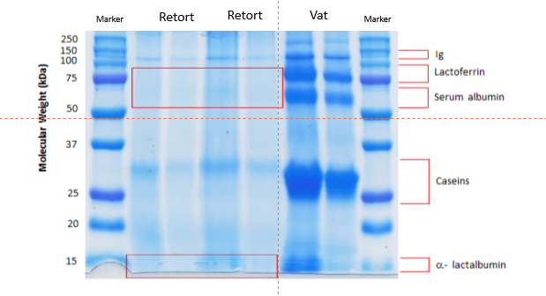
Human Milk: A Source of More Life Than We Can Imagine
Gel Plate Comparison of Human Milk Post-Pasteurization
Human milk processed using retort sterilization vs vat pasteurization-you can clearly see the void in bioactivity in those samples that had been sterilized.
Notes:
Gel plate comparison of milk that has been processed using retort sterilization vs vat pasteurization-you can clearly see the void in bioactivity in those samples that had been sterilized.

Slide 34
Human Milk: A Source of More Life Than We Can Imagine
The growth and neurodevelopmental needs of the “evolutionarily new population of very premature infants” are best met by the appropriate fortification of human milk.”

Slide 35
Connect with Us
NICU Dietitian Support NAC@prolacta.com
NICU Nurse/NNP Support NPAC@prolacta.com

Slide 36
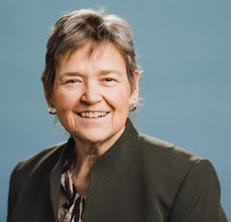
Speaker Contact Information:
Terry S Johnson, APN, NNP-BC, ASPPS, CLEC, MN
Director, Education and Professional Development
Prolacta Bioscience
Email: Tjohnson@prolacta.com
Cell: 630.881.2606

