Slide 1
Palliative Care in the NICU ICANN May 20th, 2021 Sara Molina, MSN, MBE, RN

Slide 2
Objectives
What is palliative care (PC)?
Define Neonatal Palliative Care (NPC)
Implementing NPC
Care of the caregiver
Review case study

Slide 3
What is Palliative Care?
Palliative care is specialized medical care for people living with a serious illness. This type of care is focused on providing relief from the symptoms and stress of the illness. The goal is to improve quality of life for both the patient and the family.
Palliative care is provided by a specially-trained team of doctors, nurses and other specialists who work together with a patient’s other doctors to provide an extra layer of support. Palliative care is based on the needs of the patient, not on the patient’s prognosis. It is appropriate at any age and at any stage in a serious illness, and it can be provided along with curative treatment.
-Center to Advance Palliative Care (CAPC)

Slide 4
What Is Palliative Care?
“WHO defines palliative care as the prevention and relief of suffering of adult and paediatric patients and their families facing the problems associated with life-threatening illness. These problems include the physical, psychological, social and spiritual suffering of patients, and psychological, social and spiritual suffering of family members.”
“PPC requires attention to physical, developmental, psychosocial, ethical, spiritual and relational phenomena that are unique to children.”
-World Health Organization

Slide 5
What Is Pediatric Palliative Care?
“Pediatric palliative and/or hospice care is both a philosophy and an organized method for delivering individualized care to children with life-threatening conditions. This care focuses on enhancing quality of life for the child and family, preventing and/or minimizing suffering, optimizing function, and providing opportunities for personal and spiritual growth. As such, it can be provided along with concurrent life-prolonging or curative care or as the main focus of care.”
- National Hospice and Palliative Care Organization

Slide 6
What is Perinatal Palliative Care?
“Perinatal palliative care refers to a coordinated care strategy that comprises options for obstetric and newborn care that include a focus on maximizing quality of life and comfort for newborns with a variety of conditions considered to be life-limiting in early infancy.”
- The American College of Obstetricians and Gynecologists
Notes:
Can be provided concurrently with life-prolonging treatment, as well as without intent to prolong life, which is perinatal palliative comfort care.

Slide 7
Multidisciplinary Team
Palliative Care uses a multidisciplinary team approach to provide care
Medicine, nursing, social work, chaplaincy, psychology, child life, music therapy, art therapy, animal therapy, holistic therapy
Palliative needs are subjective to each patient- the team approach allows us to meet an individual’s specific needs

Slide 8
The Palliative Care Umbrella
Palliative Care is NOT only hospice or end of life care
Under the umbrella are multiple facets of care that align with treatment oriented goals

Slide 9
PC in the NICU
“Mothers and fathers generally enter into pregnancy with anticipation and hopefulness, having a future-oriented idea of their yet to be born infant. That a newborn may be critically ill, extremely premature, or born with significant birth anomalies that threatens his/her life and wellbeing is never truly anticipated. When discovered- at birth or even beforehand with fetal diagnostics- the pregnancy generally takes a dramatic turn as hopeful anticipation is replaced by fear, joy may be eclipsed by guilt, and the experience of pregnancy and childbirth becomes medicalized- often with obsessive thoughts surrounding each clinic visit, imaging study, or test. In addition to cure-oriented and life-extending neonatal intensive care, the provision of concurrent PC may provide supportive care for the patient and family, and may help in decision-making.”
-Pediatric palliative care in infants and Neonates
Notes:
Palliative care works WITH the primary team, in this case NICU, to provide support to the pt’s family. Foundationally, PC starts at support, and if/when we need to assist in communication and medical decision-making down the road, then we already have a relationship with parents/family to help facilitate that. Our multidisciplinary team is an extra layer of support for family, and this support is useful from the beginning of a cure-oriented approach to care.

Slide 10
PC in the NICU: National Association of Neonatal Nurses
Association Position:
“Palliative and end-of-life care for infants and their families are an integral component of neonatal care, and neonatal nurses should be trained and participate in setting care goals and providing services involved in this essential care. Nurses and nurse practitioners work with physicians and others to provide symptom management, relief of suffering, and dignity for infants and families.

Slide 11
PC in the NICU: National Association of Neonatal Nurses
Excerpt from Recommendations:
Palliative care should be offered at any period in which the infant’s life may be limited- prenatally, at the time of birth, and after the birth- and in any location, including in the labor and delivery suite, in the NICU, and at home following discharge.
An advocate or palliative care provider should be identified prenatally or at delivery/diagnosis for each infant and family in need of palliative services. The advocate should be able to guide and comfort parents across the illness trajectory including prenatal, labor and delivery, and NICU care.
Palliative care family support services should include perinatal/neonatal social workers, hospital chaplains, and clergy, and palliative care team members to provide emotional and spiritual support, a child-life specialist or family support specialist to support the infant’s siblings, a parent who has had a child in the NICU to assist with navigating the NICU experience, and a lactation consultant t assist mothers who want to breastfeed their infant or donate breast milk at the end of life and to help mothers manage cessation of lactation.
Notes:
We want to initiate PC as early as possible, with the notion that the longer we have to be supportive to family and build a relationship with them, the better. We are starting to work with NICU, as well as MFM, to initiate care as early as possible in the care trajectory. Ideally, for a known issue, we will see mom first either as an outpt or on L&D, and then continue to care for her/baby once baby arrives. Again, PC is multifactorial in support and can assist in initiating spiritual and social support, as well as utilizing child life and psychology.

Slide 12
What Is Pediatric Palliative Care?
Pediatric palliative care is NOT only for hospice/end of life patients
Notes:
Hospice and end of life care is under the same umbrella as PC, but it is not the same thing. The biggest piece to remember in regards to pediatric palliative care is that the purpose first and foremost is support, and we can and should be initiated at the diagnosis of a life-threatening or life-limiting diagnosis, with the intent of cure.

Slide 13
Why PPC?
Complex medical diagnoses: sometimes known, sometimes unknown prognostic ability
Children with certain disorders/diseases are living longer than ever before
In 2013, there were 18,888 deaths in children ages 1-19 years, representing a death rate of 24 per 100,000
Notes:
Depending on the diagnosis, patients and families may have several specialists involved in their child’s care; these diagnoses are often chronic, and may be difficult to prognosticate. Certain diagnoses become chronic and patients and families have a completely “new normal” that they have to work through/deal with. Early integration of palliative care can help minimize the disconnect between services/care teams and aid in clear, concise communication, can offer support for patient/family, and can help in decision making if/when the time comes to make treatment decisions and/or end of life decisions.
Medical advances in technology as well as pharmaceuticals have given us more time with children of certain diseases/disorders than ever before. With these advancements comes a longer trajectory for patients, making their palliative care needs ongoing. It also leads to really important decision making for patients and families.
Deaths in children continue to decrease (YAY!), however I read that number and think 20,000 and children death in the same sentence is devastating. My second thought/question is what that journey looked like for that patient and family, if they endured suffering, if mom and dad have any regrets from that journey. On a personal/anecdotal note, I had a 5 year old patient with leukemia, had gone through 2 bone marrow transplants, and was hospitalized for a systemic fungal infection. Over the course of a month she continued to decline, and ended up in the ICU intubated. Code status had been brought up to mom and dad and they wanted their daughter to remain a full code, and also stated that while intubated/sedated that she was finally resting after a month of suffering, and was regaining her strength to fight the cancer again. I’m not exactly sure what the conversations between parents and healthcare team were, but from a nursing perspective it was one of those “what are we doing?” cases. While in ICU, the patient coded. Dad was present for the code and CPR and at the beginning was screaming and hysterical; after a period of time, Dad told them to stop. CPR was stopped and the patient died. I talked to Dad after and he said, “I wish the end was different. I feel terrible and responsible for how my daughter died, and we didn’t get to say goodbye.” I remember being in that moment like it was yesterday, and certainly learned a life lesson in terms of pediatric palliative care- one of our goals should be to provide families with clear, concise information and support families in the decision making process, continuing to reassess, clarify goals, and offer validation of their thoughts and feelings in this intense, trying, horrific situation. There is no right or wrong answer, mom and dad are making the best decision that they can for their child with the provided information, but our job is to make sure there is clear communication and understanding of the provided information. In doing so, the hope is such that we are mitigating the risk of guilt for that parent or family member. One of my goals as a pediatric palliative care nurse is to never hear “I wish the end was different” again.
NHPCO facts and figures

Slide 14
Why PPC?
Notes:
CCC: Complex Chronic Conditions are medical conditions that can reasonably be expected to last at least 12 months, unless death intervenes, and either to involve several different organ systems or to involve one organ
system severely enough to require specialty pediatric care, with a likelihood of some period of hospitalization in a tertiary care center.

Slide 15
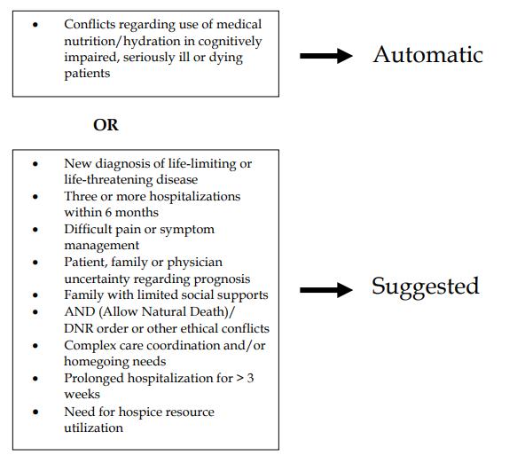
What diagnoses?
General referral criteria: presence of a chronic, complex, or life-threatening illness/condition and one or more of the following:
Notes:
Capc (center to advance palliative care) pediatric palliative care referral criteria

Slide 16
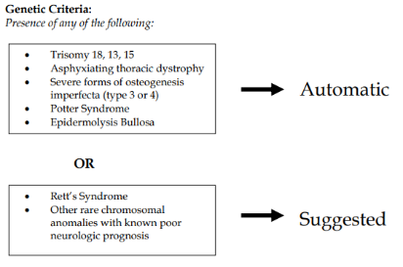
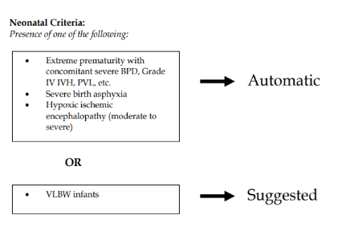
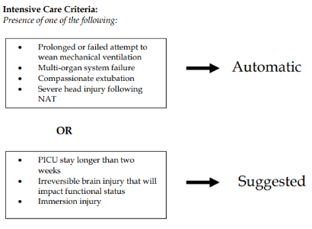

Slide 17
Diagnoses in the NICU
Genetic/chromosomal:
Chromosomal aneuploidies with complex and life-limiting prognoses
Severe metabolic, storage, or mitochondrial disorders
Severe forms of skeletal dysplasia

Slide 18
Diagnoses in the NICU
Organ-system problems:
Severe central nervous system (CNS) malformations (neural tube defects, migrational disorders)
Hypoxic- ischemic encephalopathy
Spinal muscular dystrophy type-1 and myotonic dystrophies
Epidermolysis bullosa
Potter’s syndrome
Fetal oligohydramnios sequence
Fetal-neonatal chronic renal failure
Short-gut syndrome with parenteral nutrition dependence
Multi-visceral organ transplant under consideration (ie: liver, bowel, pancreas)
Biliary atresia
Total aganglionosis of the bowel
Complex congenital heart disease
Severe pulmonary hypoplasia
Consideration for heart transplant
Congenital diaphragmatic hernia
Severe pulmonary hypoplasia
Multi-organ system failure

Slide 19
Diagnoses in the NICU
Infection and immune disorders:
Perinatal HIV/AIDS
Severe combined immune deficiency (SCID)
Severe perinatal herpes simplex virus (HSV)
Cytomegalovirus (CMV)
Toxoplasmosis or Zika virus with meningoencephalitis or severe encephalopathy

Slide 20
Diagnoses in the NICU
Complications of prematurity:
Periviable gestation
Severe intraventricular hemorrhage or periventricular leukomalacia
Refractory respiratory failure
Ventilator- dependent BPD
Severe necrotizing enterocolitis (NEC) with resultant short gut
Liver failure

Slide 21
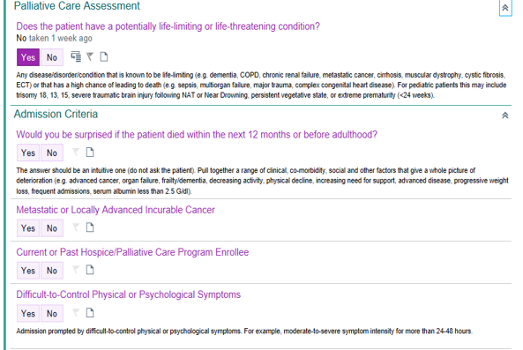
What diagnoses?
Notes:
This palliative care assessment is on the admission tab for the nurse to complete. It creates a trigger to the physician to place an order for a palliative care consult. “Does the patient have a potentially life-limiting or life-threatening condition?” “For pediatric patients this may include trisomy 18, 13, 15, severe traumatic brain injury following NAT or near drowning, persistent vegetative state, or extreme prematurity <24 weeks”
This is a guideline, it is NOT an inclusive list; part of the purpose of this education is to hopefully empower you as nurses to recognize pediatric palliative care as a need for your patients and advocate for them.

Slide 22
Pediatrics vs. Adults
Children are not mini adults
Developmental differences
Resiliency in pediatric population
Community presence (ie: school)
Impact on families: emotional, psychological, spiritual, financial, grief
Notes:
Different disease states/illnesses, different symptoms, different needs; foundationally PPC is an added layer of support for pt and family, and from creating that relationship we can insert our services into other aspects of care such as symptom management, decision making, and end of life care. PPC is not a “one size fits all” type of care, it is malleable to the specific needs of the pt/family.
Developmental differences play an important role in PPC so we can tailor our care depending on where the child is developmentally. In a child who has had a lifetime of chronic illness and is 10, their perspective and insight on their health and well being will most likely be more mature than a 10 year old with an acute situation who has never experienced hospitalization, illness, etc. Likewise, how we communicate with a 5 year old about how they are feeling is going to be different than a 15 year old, and we have to be able to recognize the developmental stage of a patient and communicate appropriately.
Resiliency! Kids are resilient. This is probably one of the most distinct differences between the pediatric and adult population. Resiliency is such a positive, key facet of pediatric care, however it makes it more difficult in diagnosis, prognosis, and medical management for these children.
Often, children are part of a much bigger social situation and community that they should continue to be part of. School, church, sports, after school groups- kids should maintain the opportunity to be part of these activities to the degree they are able.
The impact on the family unit is huge. It stretches from the emotional state of the family members to the financial, to the spiritual. Often times there are other children in the family and their needs in this situation are unique (ie: guilt, jealousy, feelings of neglect). Given the financial burdens, a lot of time one or both parents have to remain working. Spiritually, some patient and families cling to their faith and religion in these situations, and sometimes it makes them feel disconnected and question their spirituality. If a patient dies from their disease, the grief a family goes through is devastating and can be long term- and includes family, extended family, and community.

Slide 23
PPC @ RUHS
Palliative care consult is an MD order
Our team gets notified of new consult and will consult with referring team prior to seeing patient/family
Our first goal: provide support for patients and families by creating therapeutic relationship
Be present for patient/family/healthcare team to assist in other needs as needed
Provide support for staff members: committee meetings, debriefings
Notes:
Consult is an MD order but again, if you feel like your patient and/family could benefit from palliative care support, please say so! You are their advocate!
We will ALWAYS consult the referring physician before seeing the patient/family, and will get the bedside nurse’s input as well
We work in conjunction with primary service teams. We are an added layer of support.
As other needs arise, we are present. Communication needs, assistance with family meetings or decision making…our hope would be to have already created a relationship with patient/family and so as these other needs arise, we are a known and trusted service
Staff support- this is huge! Your job is HARD!!! It takes a toll on you physically, emotionally, mentally…we are here for you and want to support you. I’d like to start a unit palliative care committee, where we can meet once a month or once every two months, have case studies, debriefings, education, discussion. One on one conversations on the unit- 5 free minutes to chat/vent/cry/whatever you need to do.
Great working relationship with LLU palliative care- warm handoffs between two teams maintains continuity of care

Slide 24
RUHS Medical Center Palliative Care Team
Ron McCowan, MD- Medical Director
Amar Dave, MD
Angel Rosilez, NP
Erin Sullivan, NP
Cori Hendra, RN, BSN, CHPN- Coordinator
Sara Molina, RN
Javier Chavez, LCSW
Adriana Gomez, LCSW
Moon Rhee, Chaplain
Margaret Kennedy, Chaplain

Slide 25
Final Thought…
“PPC-PHC guidelines and recommendations include ensuring that all large health care organizations serving children with life-threatening conditions have dedicated interdisciplinary PPC-PHC teams, which should develop collaborative relationships between hospital and community based teams…”
-American Academy of Pediatrics
Notes:
Anyone in need of palliative care services should be able to receive them. 0-110, if the need is there, patients should be given the opportunity to receive palliative care. We are excited to be working with peds, PICU, and NICU to provide palliative services to patients and families in need, and are always open to your questions, suggestions, or concerns.

Slide 26
Questions? Sara Molina sara.molina@ruhealth.org Ext. 18957

Slide 27
Carter, B. (2018). Pediatric palliative care in infants and Neonates. Children, 5(2), 21. doi:10.3390/children5020021
National Association of Neonatal Nurses. (2015, February). Palliative and End-of-Life Care for Newborns and Infants. Retrieved March, 2021, from http://nann.org/uploads/About/PositionPDFS/1.4.5_Palliative%20and%20End%20of%20Life%20Care%20for%20Newborns%20and%20Infants.pdf
National Hospice and Palliative Care Organization. (2014, September). NHPCO Facts and Figures: Pediatric Palliative and Hospice Care in America. Alexandria, VA. Retrieved March, 2021, from https://www.nhpco.org/wp-content/uploads/2019/04/Pediatric_Facts-Figures-1.pdf
NHPCO. (2019, July). Standards Of Practice For Pediatric Palliative Care. Retrieved March, 2021, from https://www.nhpco.org/wp-content/uploads/2019/07/Pediatric_Standards.pdf
World Health Organization (2018). Integrating palliative care and symptom relief into paediatrics: a WHO guide for health care planners, implementers and managers. Retrieved March, 2021.

